Slide 1
AB “Energijos skirstymo operatorius” Financial results for 6 months of 2018
2018-09-05

Slide 2
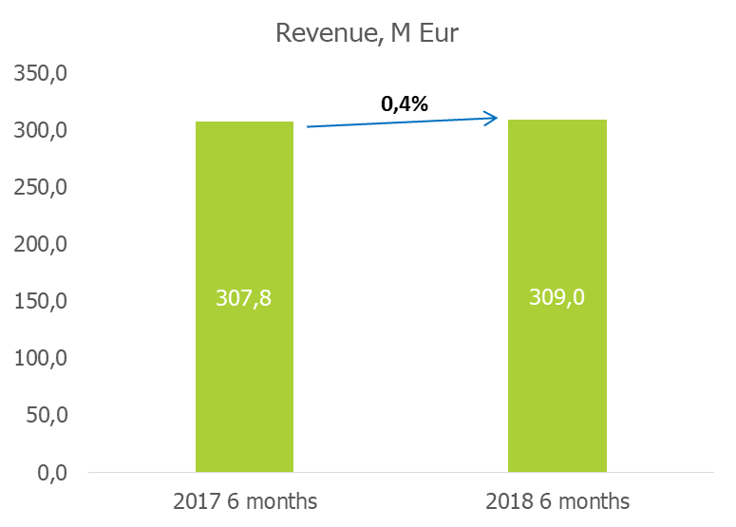
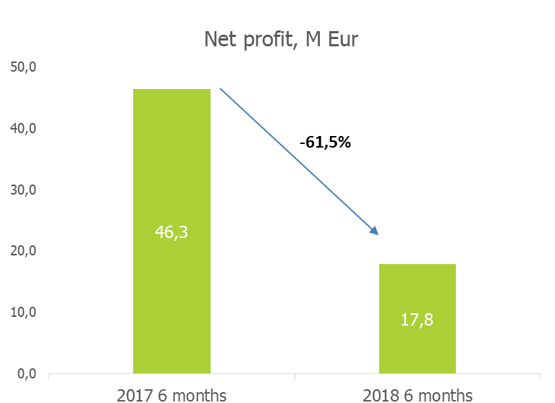
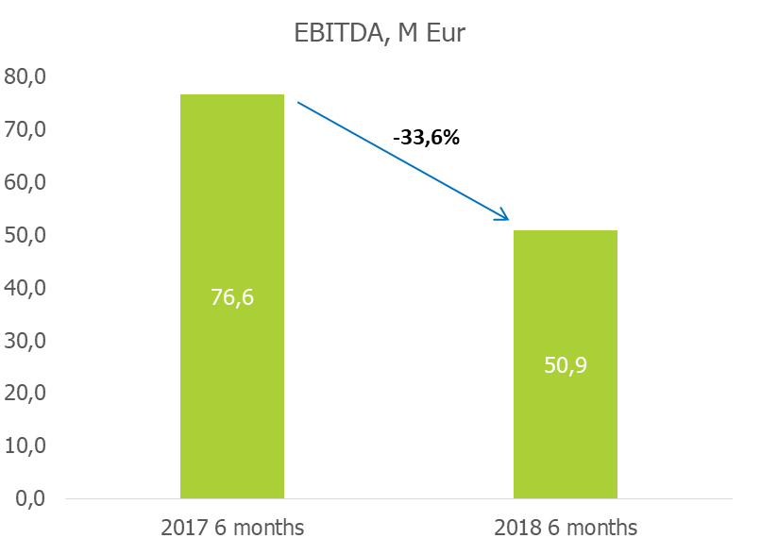
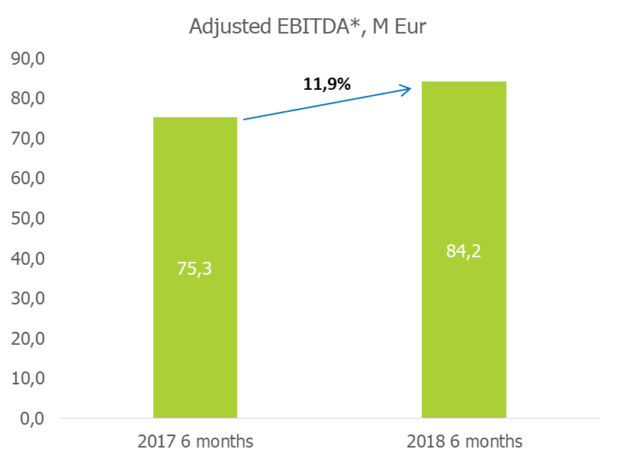
Main financial ratios
The main reason of net profit decrease:
26.8% higher average wholesale electricity price on the „Nord Pool“ electricity exchange in Lithuania price area than during the same period of 2017
(2018 - 43,7 EUR/MWh;
2017 - 34,4 EUR/MWh).
*The adjusted EBITDA is calculated by adding the impact of the recalculation of regulated activities revenue generated in prior periods (as established by respective resolutions of the Commission) and by eliminating the difference that arose during the reporting period between the return on investments permitted by the Commission and the return of investments calculated by the management. The management estimates that the adjusted EBITDA indicator more accurately reflects the Company’s performance and allows to better compare results between the periods, as it presents the actual amount of revenue earned by the Company during the reporting period, as well as by eliminating the differences arising between the return on investments permitted by the Commission and the actual return on investments of prior periods which might have both a positive and negative effect on the results of the reporting period.
The adjusted EBITDA indicator is not calculated using data presented in the financial statements.

Slide 3
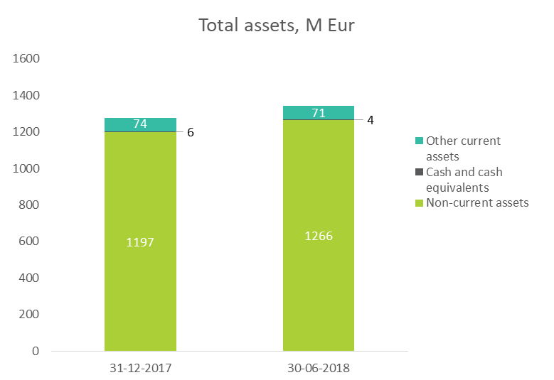
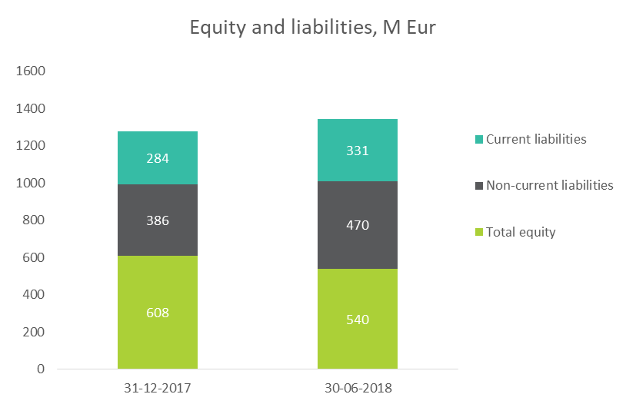
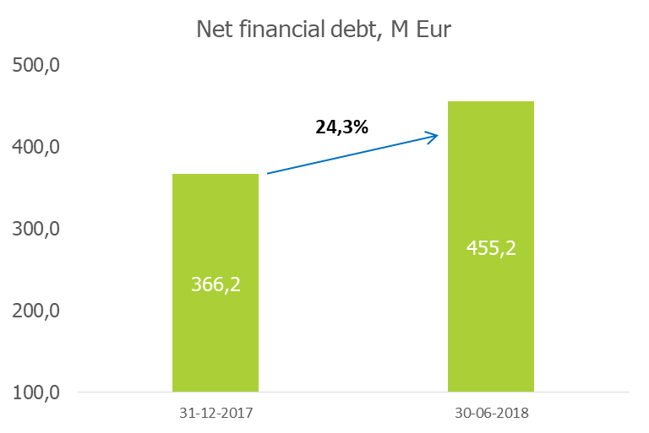
Assets, equity and liabilities
Non-current assets accounted for 94.4% of the total assets. During the reported period non-current assets increased by 5.7 %.

Slide 4
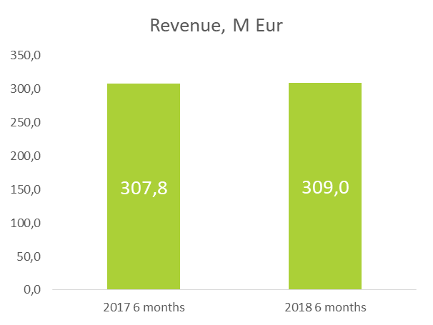
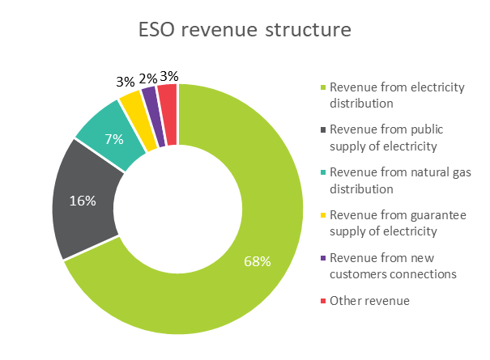
Revenue
ESO’s revenue for 6 months of 2018 reached EUR 309,0 million, which is a decrease of 0.4% compared to 6 months of 2017. Revenue increased due to higher volumes of electricity and natural gas distributed to the Company’s customers.
Revenue from electricity distribution is the main source of the Company’s revenue. In 6 months of 2018, distribution revenue comprised 68%.

Slide 5
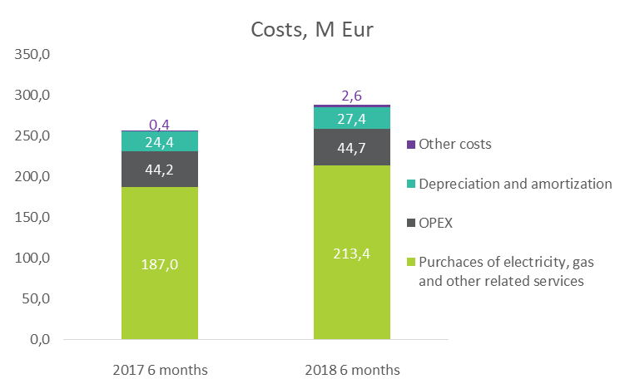
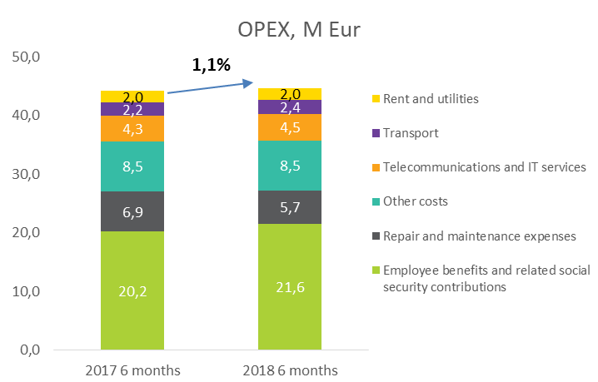
Costs
In 6 months of 2018, purchases of electricity, natural gas and related services made up EUR 213.4 million and increased by 14.2% compared to 6 months of 2017. This was mainly influenced by increased electricity purchase price.
In 6 months of 2018, operating expenses increased by 1.1% compared to the same period of 2017 and amounted to EUR 44.7 million.

Slide 6
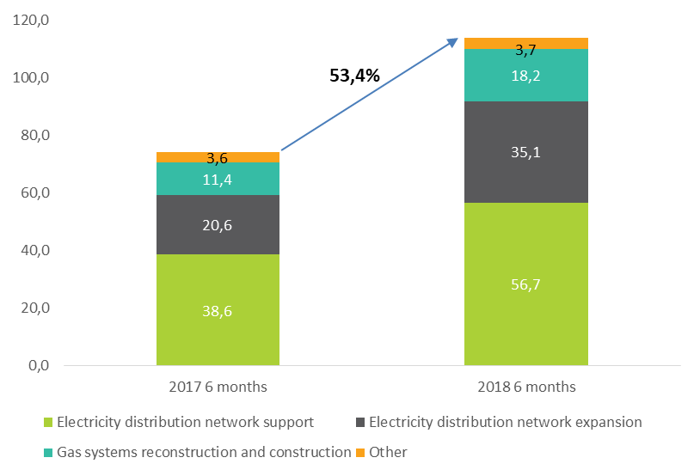
Investment, M Eur
In 6 months of 2018 ESO’s investments in the electricity and gas distribution networks amounted to EUR 113.7 million, which is 53.4% more than in the same period of 2017 when they were equal to EUR 74.1 million.

Slide 7
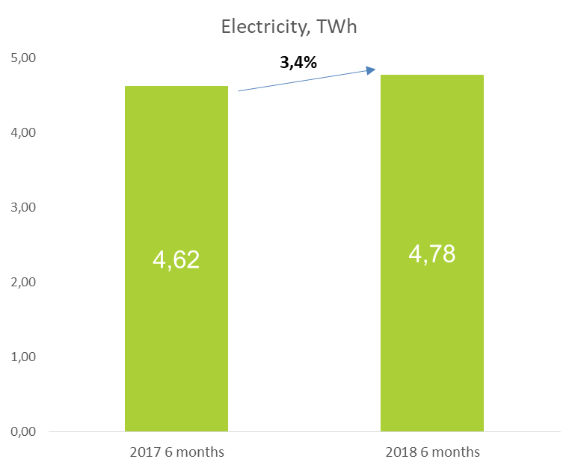
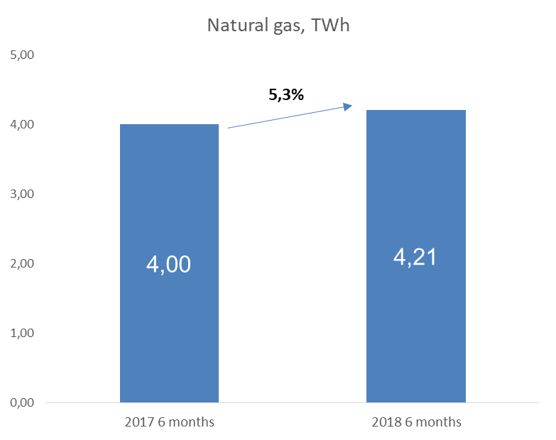
Distributed volumes
The volume of electricity distributed increased by 3.4% compared to the same period in 2017 due to country GDP growth of 3,7% compared to the same period last year.
In 6 months of 2018, ESO transported approximately 5.3% more natural gas than in the same period in 2017. Gas distribution volumes increased mainly due to a higher gas consumption as a result of colder weather and changes of production plans in industrial companies.

Slide 8
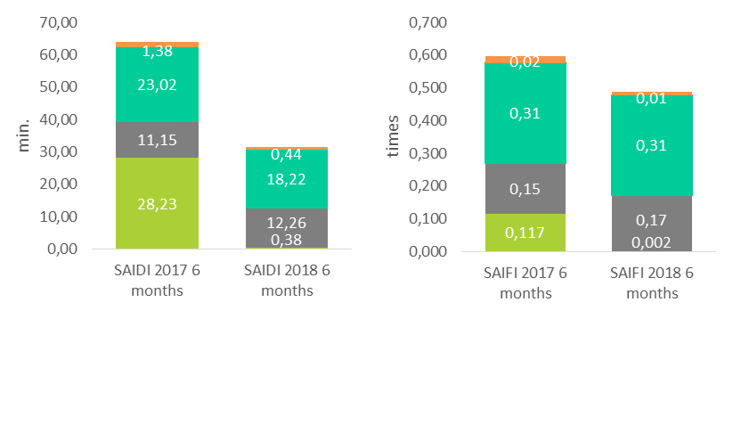
Electricity quality indices
During 6 months of 2018, the system average interruption duration index (SAIDI) per customer decreased by 32.5 minutes, the system average interruption frequency index (SAIFI) per customer was 0.11 time less compared to 6 months of 2017.

Slide 9
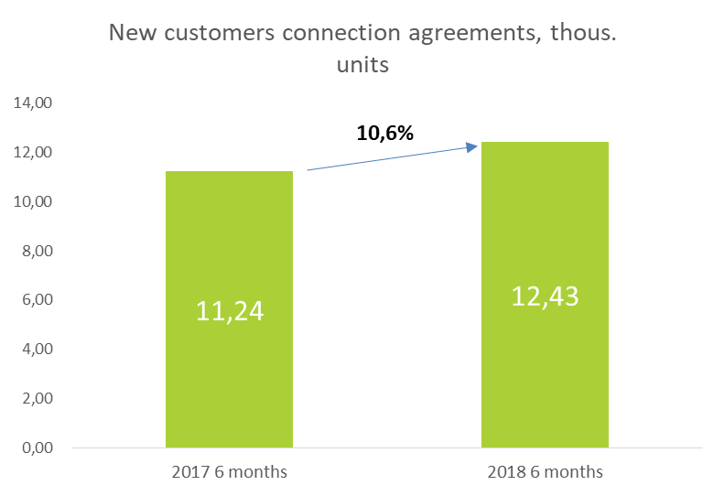
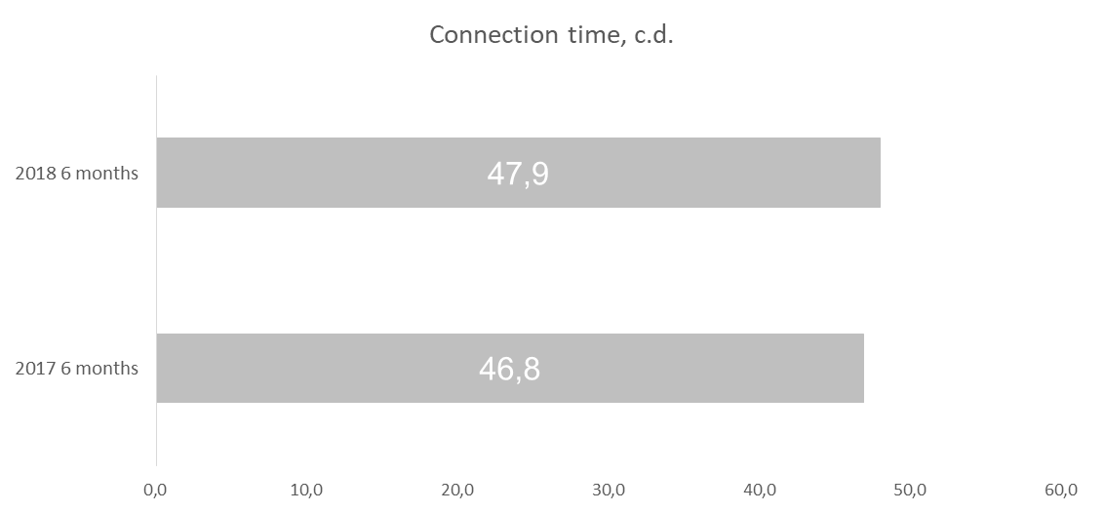
Connection of new customers - ELECTRICITY
In 6 months of 2018 ESO signed about 11% more new customers connection to the electricity distribution network agreements than in the same period in 2017.
Connection time increased by 1 calendar day.

Slide 10
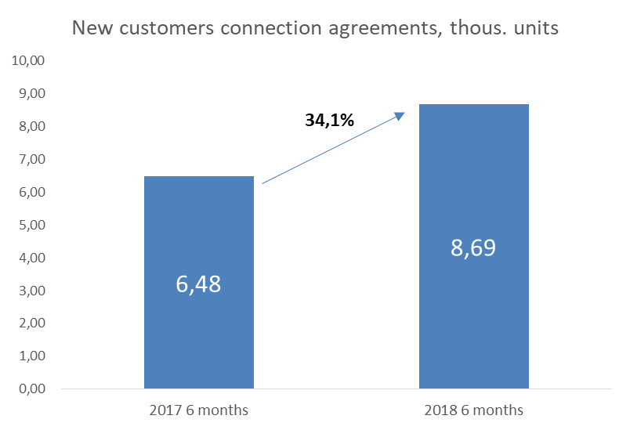
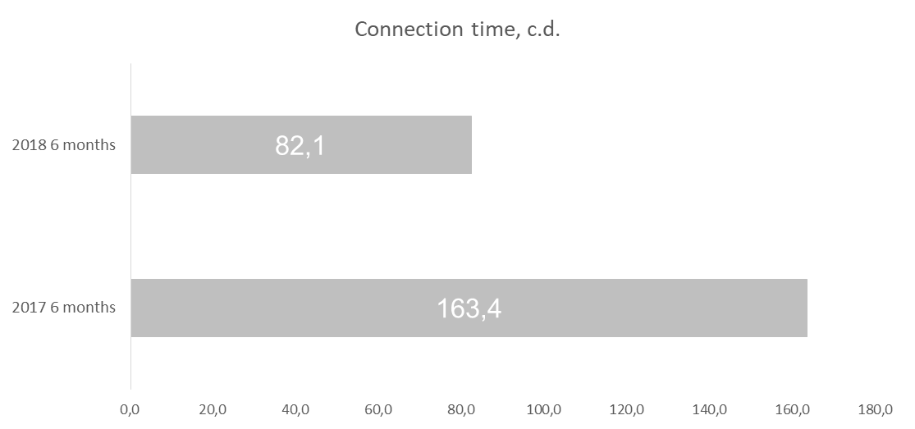
Connection of new customers – NATURAL GAS
In 6 months of 2018 ESO signed 34% more new customers connection to the natural gas distribution network agreements than in same period in 2017.
Connection time decreased by 81 calendar days.

Slide 11
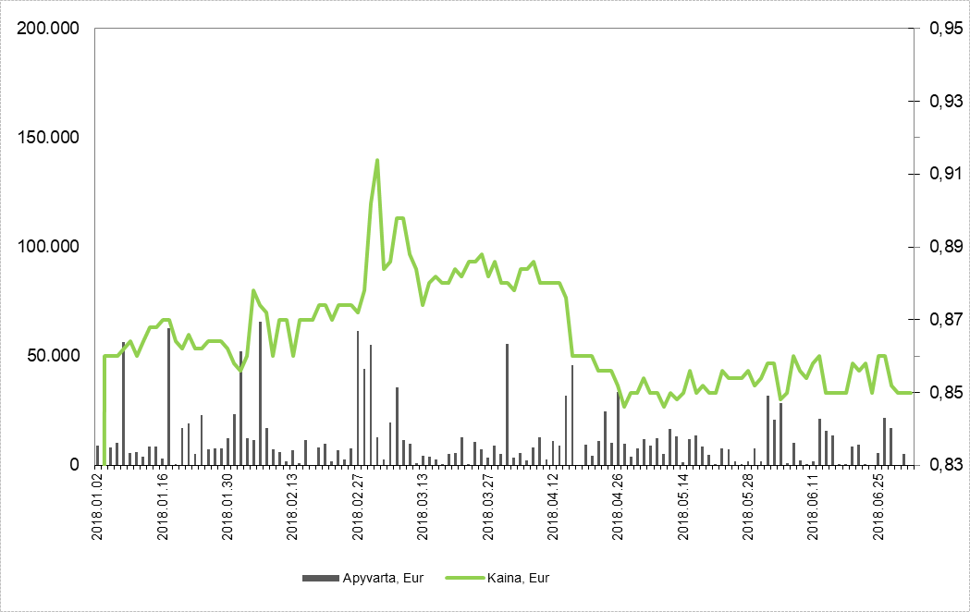
Share price and shareholders
Main shareholder was „Lietuvos energija“, UAB holding 94.98% of shares, with the rest floating.
ESO – the largest company by market capitalization on NASDAQ Baltic Exchange (760.44 mln. EUR). The weighted average price during the reporting period was EUR 0.865.

Slide 12
AB “Energijos skirstymo operatorius”
Company code 304151376
VAT code LT100009860612
Aguonų g. 24, Vilnius, 03212 Lithuania
Tel. (8 5) 277 7524
Fax. (8 5) 277 7514
info@eso.lt
www.eso.lt

